Slide 1
How to fill out your Domestic Common Use Ancillary Space Request Form

Slide 2
What is Ancillary Space and the purpose of this request form?
Ancillary Space is are the areas of Common-Use facilities as defined in the CDA’s Capacity Declaration. These positions include:
Check-in positions (Requested per position for passenger check-in)
Baggage make-up (Requested per position for baggage handling)
This form is used by the Airline Station Managers to submit their requests for the use of Ancillary Space in a Common Use environment to the Airport Scheduling Manager.
Terminal Space Use Protocols (TSUPs): govern the priorities, procedures and requirements for the assignment and use of Common Use Premises, Preferential Use Premises, and Exclusive Use Premises in the Terminal Complex and on the Apron Area, including Gate Space and Hardstand Space, Check-in Space, and Baggage Systems use, assignment, scheduling, and accommodation at O’Hare International Airport (the “Airport”).

Slide 3
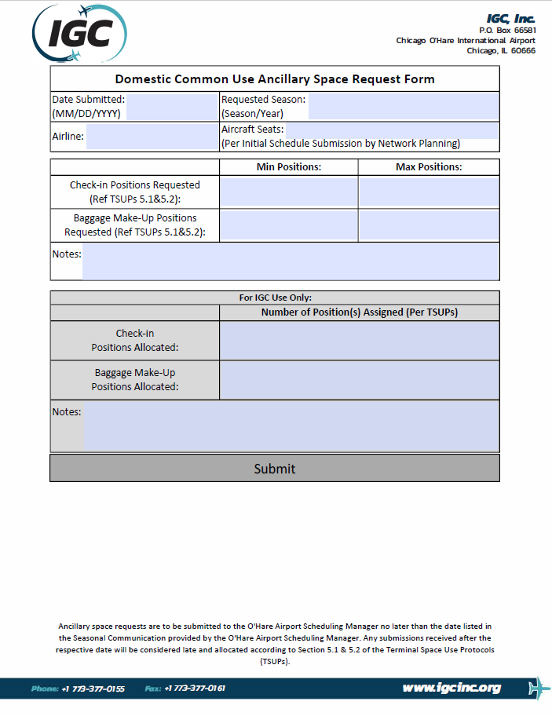
Steps on how to fill out the Domestic Common Use Ancillary Space Request Form?
This is what the Domestic Common Use Ancillary Space Request Form looks like.
How to fill out this form will be detailed in the following slides.
This form is placed on the IGC Inc. website at: https://www.igcinc.org/ohare-international-airport/
Under the associated scheduling season, the file name is ‘Domestic Common Use Ancillary Space Request Form’
To fill out and submit this form correctly, it must be SAVED to the individuals computer and opened in Adobe Acrobat.

Slide 4
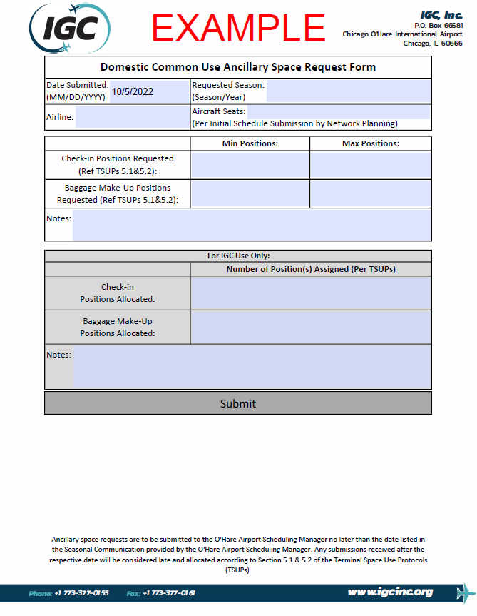
How to fill out the Domestic Common Use Ancillary Space Request Form
First, insert the Date Submitted which this form in being filled out. This format should be (MM/DD/YYYY).

Slide 5
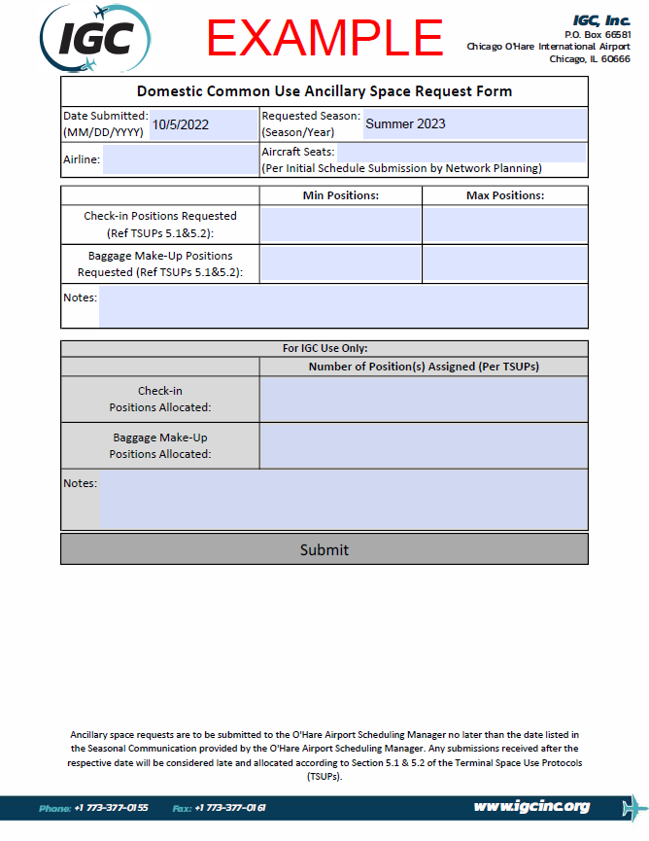
How to fill out the Domestic Common Use Ancillary Space Request Form
Next, insert the Requested Season which this form in being filled out for. This format should be (Season/Year).
This Airline is submitting for the Summer 2023.

Slide 6
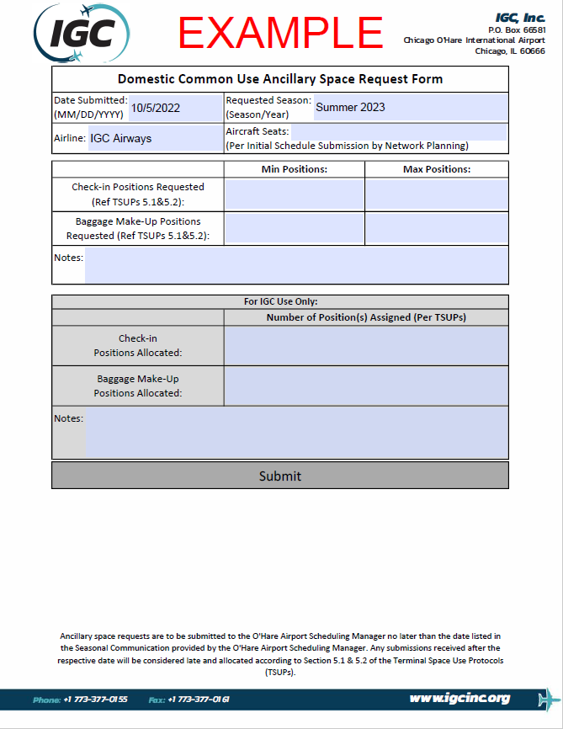
How to fill out the Domestic Common Use Ancillary Space Request Form
Then, insert the Airline which is filling out this form.
This airline is “IGC Airways”.

Slide 7
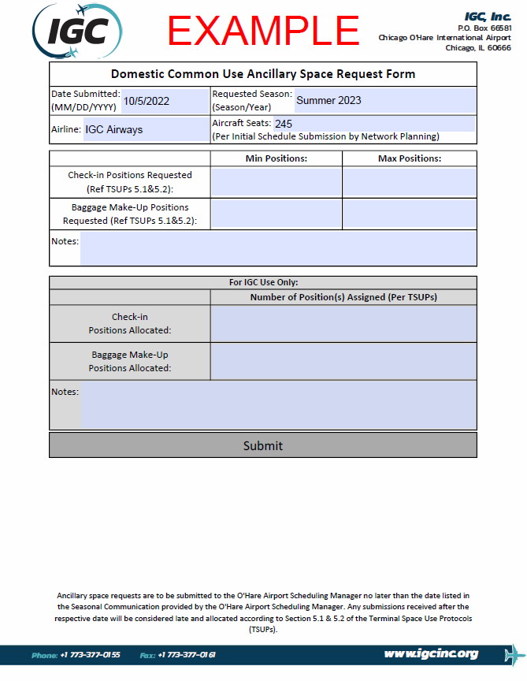
How to fill out the Domestic Common Use Ancillary Space Request Form
Regarding Aircraft Seats, this can be filled out by the individual airline; however, this must match the Aircraft Seats listed in the Initial Schedule Submission sent by the airlines Network Planning department.
IGC Airways has “245 aircraft seats”.
The Aircraft Seats listed in the Initial Schedule submission will ALWAYS be used.

Slide 8
How to fill out the Domestic Common Use Ancillary Space Request Form
Regarding Check-in Positions, these are the individual computer position(s) each agent will use to check-in passengers. These can be requested based on operational needs but may be assigned based on declared terminal capacity.
IGC Airways is requesting a minimum of 4 check-in positions, with a maximum of 6 positions.
The metrics for request and assignment are based on Section 5.2 of the Terminal Space Use Protocols (TSUPs). (see Reference Links slide).

Slide 9
How to fill out the Domestic Common Use Ancillary Space Request Form
Regarding Baggage Make-up Positions, these are the individual baggage cart locations per Make-up device. These can be requested based on operational needs but may be assigned based on declared terminal capacity.
IGC Airways is requesting a minimum of 5 baggage make-up positions, with a maximum of 6 positions.
The metrics for request and assignment are based on Section 5.2 of the TSUPs (see Reference Links slide).

Slide 10
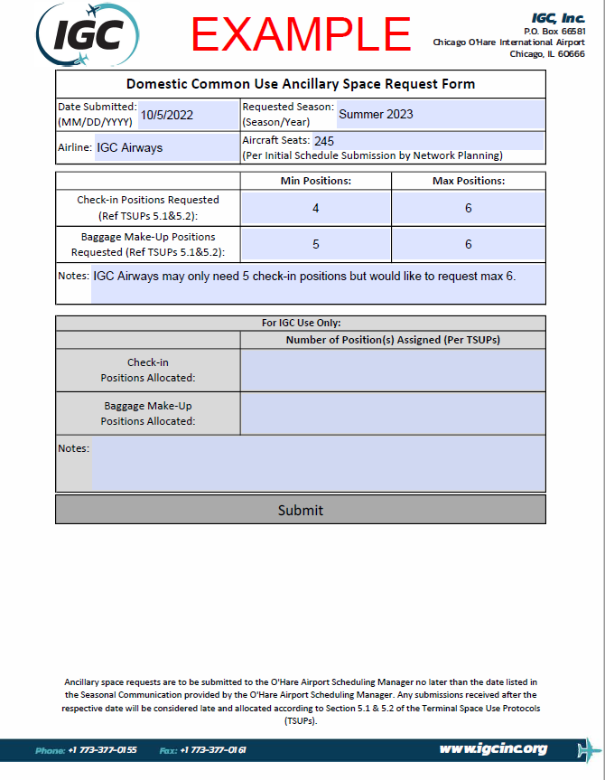
How to fill out the Domestic Common Use Ancillary Space Request Form
Notes, this area is for an airline to include any notes related to the above information. (Preferred gate requests will not be considered as part of the scheduling allocation process)
IGC Airways is noting it will only need 5 check-in positions but are requesting 6.
Some examples are:
If two partnering airlines operate within the same time and will share check-in positions.
Or additional information related to the reason a certain number of positions are being requested.

Slide 11
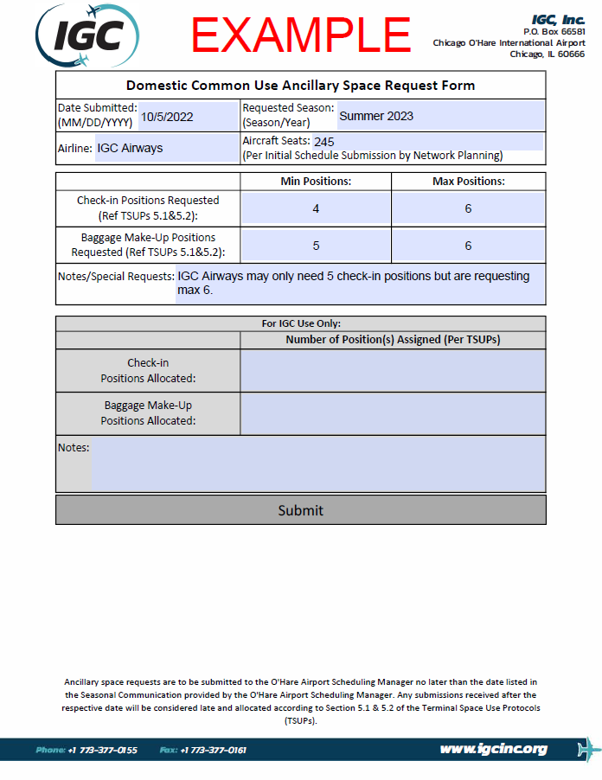
What a completed Domestic Common Use Ancillary Space Request Form should look like.
This is what a completed Domestic Common Use Ancillary Space Request Form should look like.
Instructions on how to submit this form to the O’Hare Airport Scheduling Manager are located on the next slide.

Slide 12
How to submit your completed Domestic Common Use Ancillary Space Request Form.
In order to submit this form, if it is saved correctly (refer to slide 3), the “Submit” button can be left-clicked.
This will open a draft email in your email program (I.e. Outlook), with the completed form attached.
Click “Send” in order to submit your form to the O’Hare Airport Scheduling Manager.

Slide 13
Reference Links
IGC Inc website:
https://www.igcinc.org/
O’Hare Page:
https://www.igcinc.org/ohare-international-airport/
Domestic Common Use Ancillary Space Request Form:
https://www.igcinc.org/wp-content/uploads/2022/09/DDomestic-Common-Use-Ancillary-Space-Request-Form-Fillable.pdf
This must be “Downloaded” to the individual’s computer in order to be submitted correctly.
Terminal Use Space Protocols (TSUPs):
https://www.igcinc.org/wp-content/uploads/2022/09/ORD-TSUPs-FINAL-EFFECTIVE-4.15.19.pdf

